Slide 1
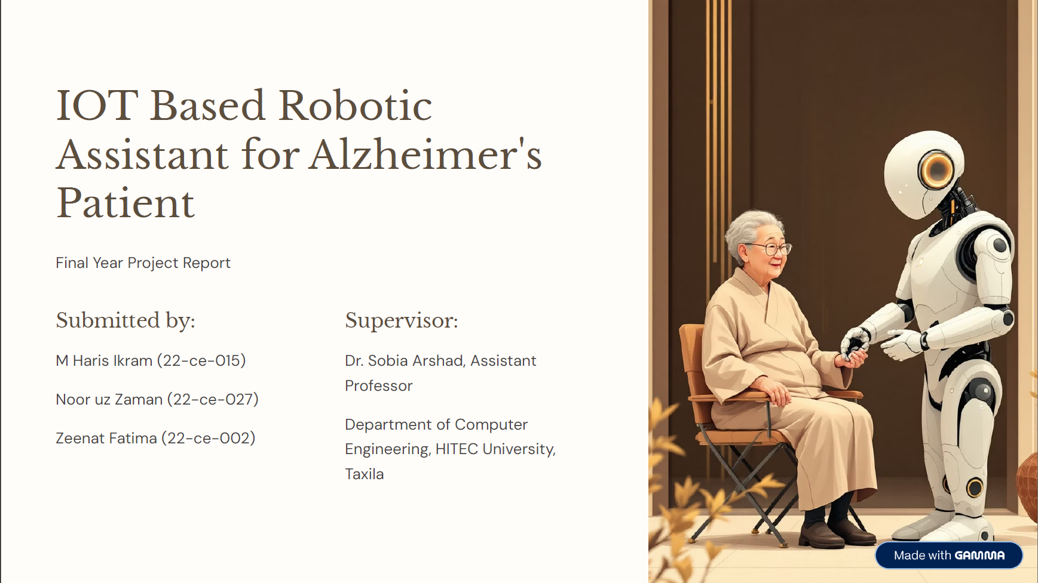

Slide 2
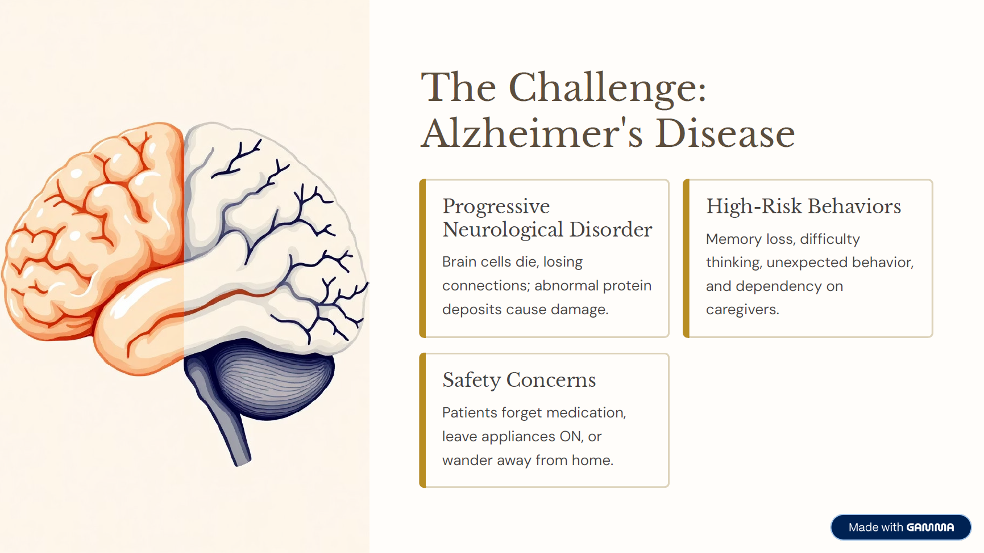

Slide 3
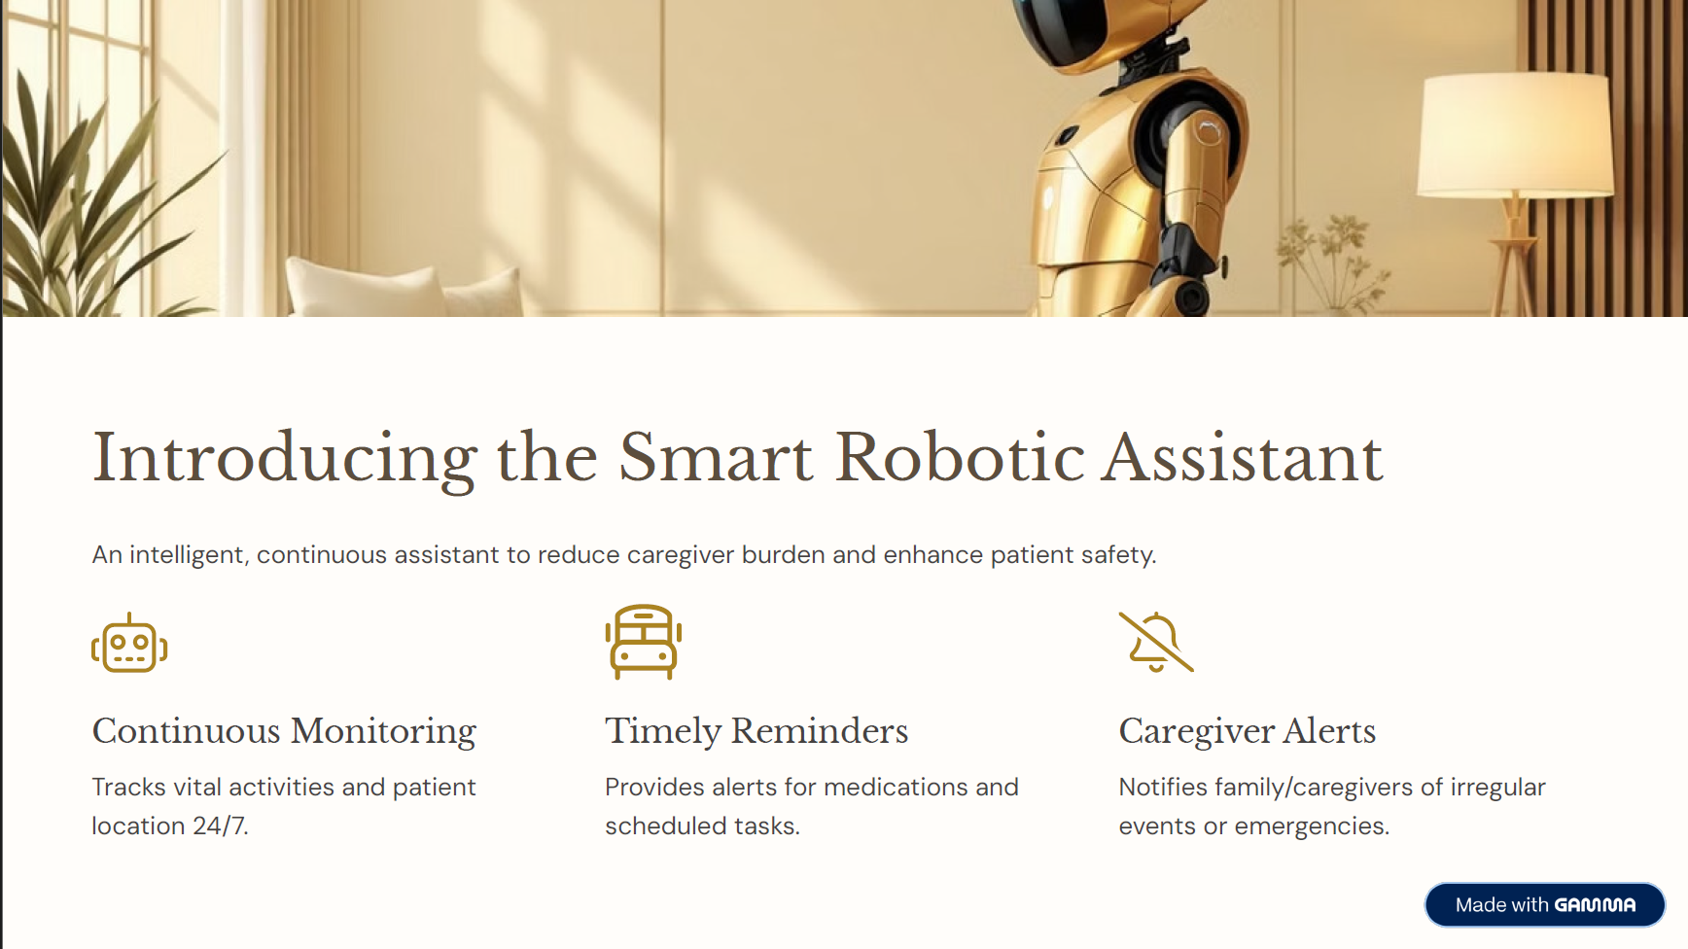

Slide 4


Slide 5
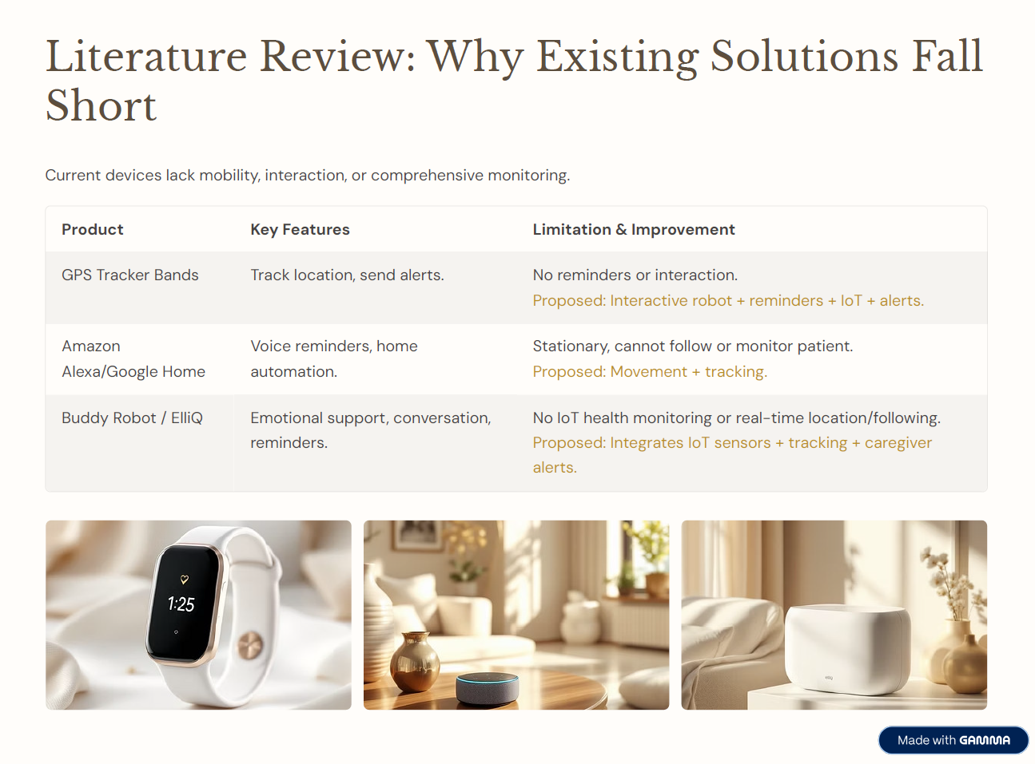

Slide 6
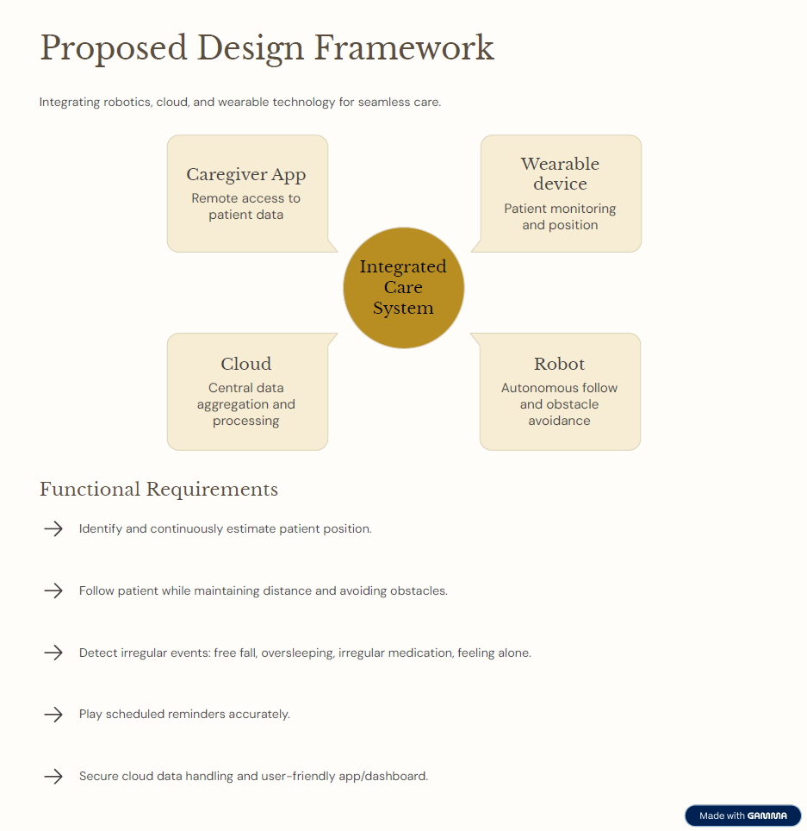

Slide 7
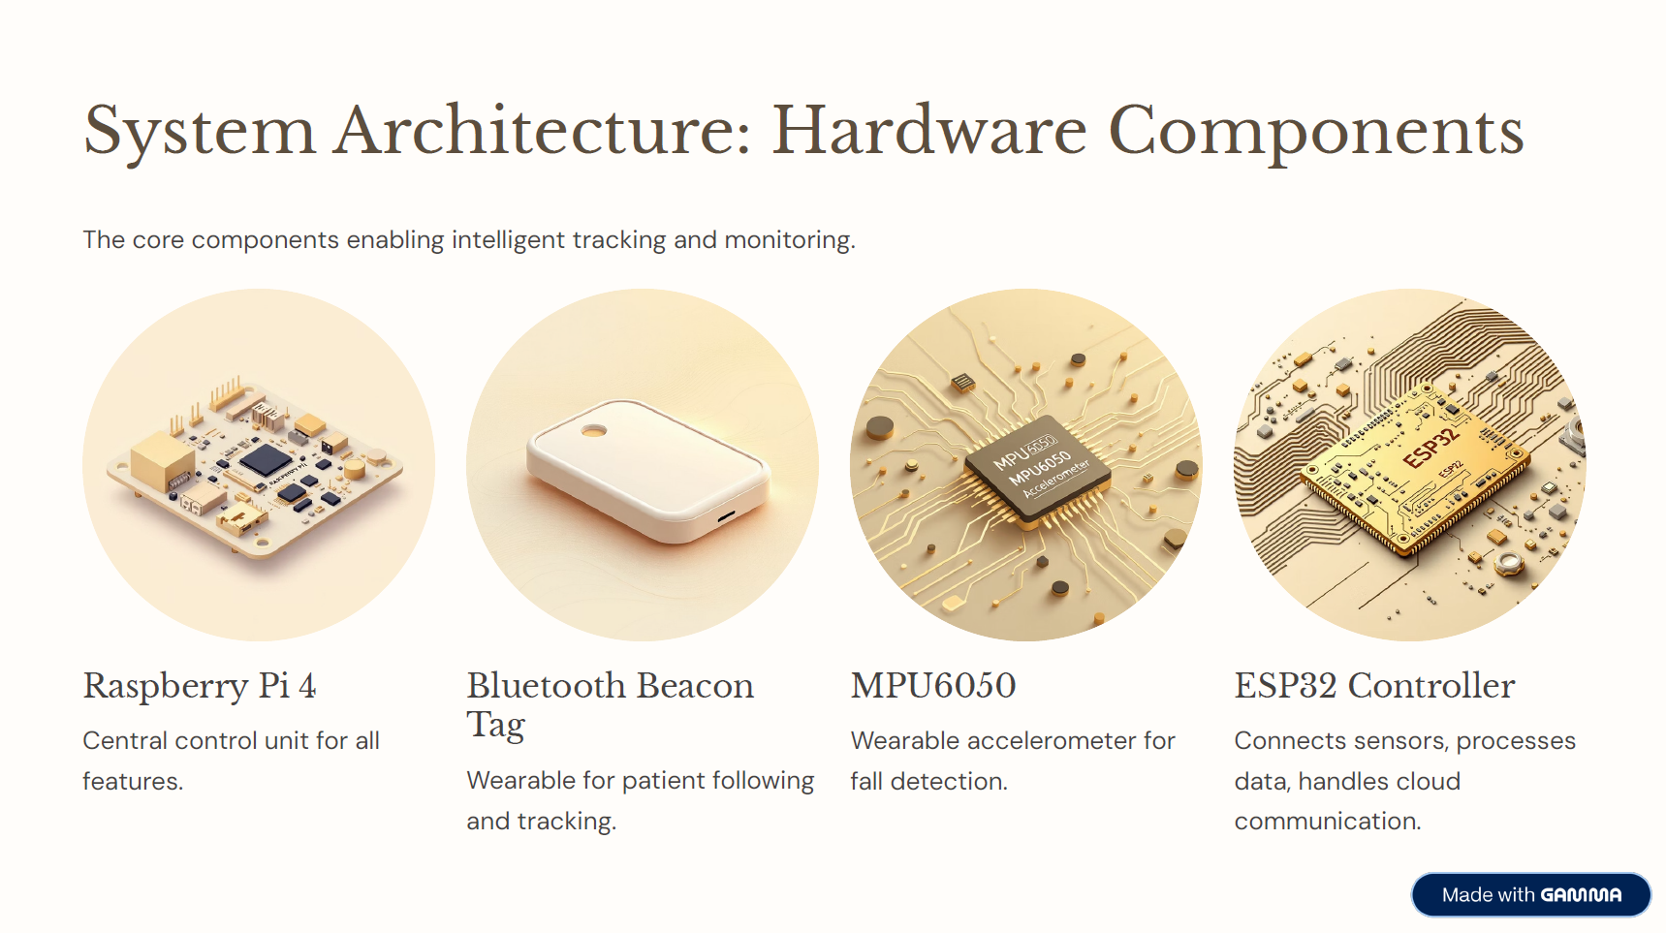

Slide 8
System Architecture: Hardware Components
System Architecture: Software Components
WebRTC (enable direct communication from camera to caregiver App).
OpenCV-DNN (detection model).
DeepSort (tracking algorithm).
Kalman Filter (motion prediction algorithm).
URFD,Le2IFD, MobiFall, MultiCam, SDUfall (vision based FD datasets).

Slide 9
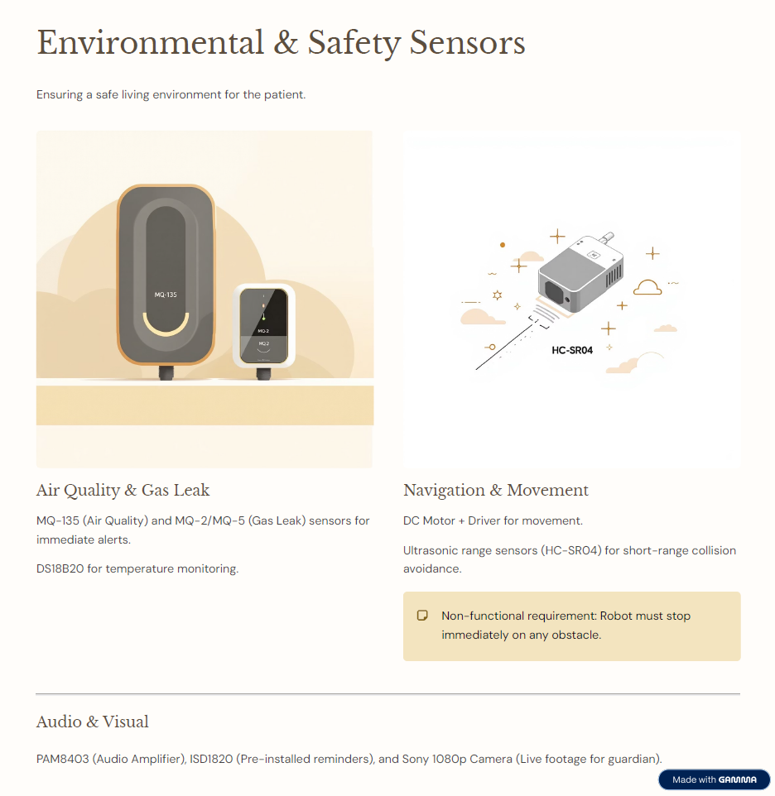

Slide 10
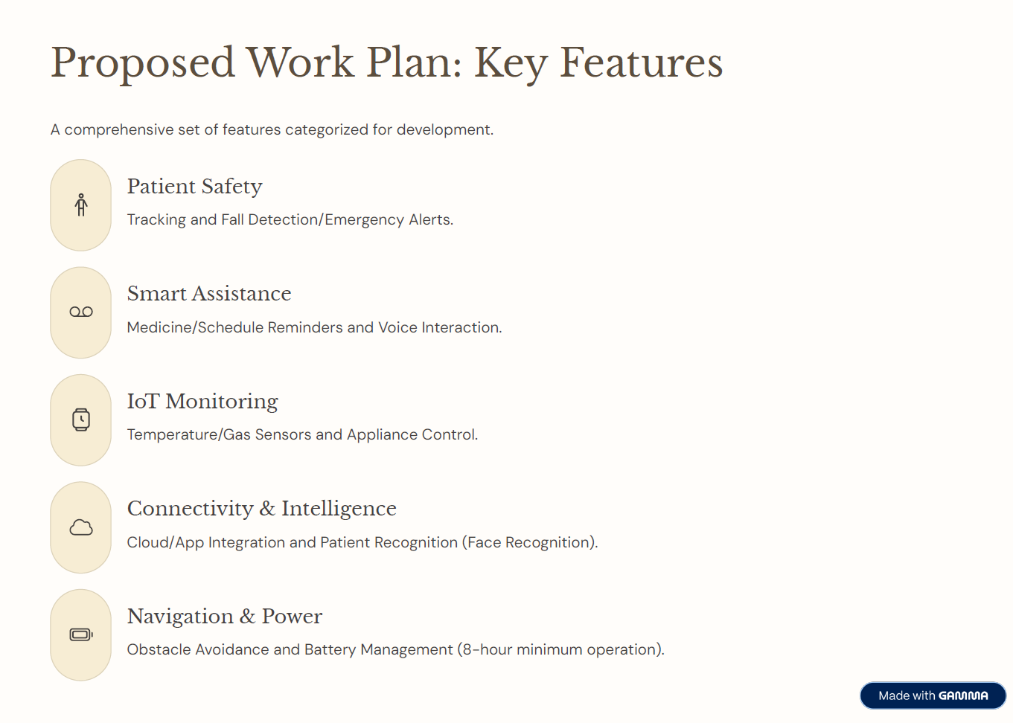

Slide 11
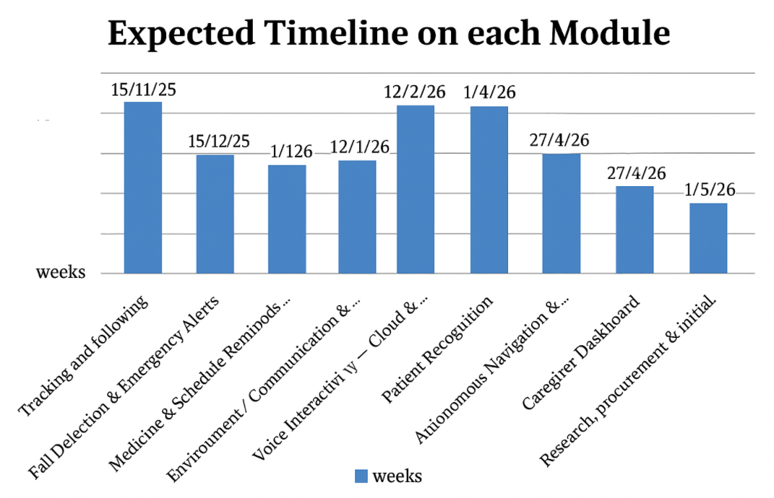

Slide 12
